Slide 1
“The tree of knowledge of Good and evil”
Gen 3:1-10

Slide 2
Theology of Communication
1. God is Communicating God
So God created mankind in his own image, in the image of God he created them; male and female he created them (Gen 1:27).

Slide 3
Theology of Communication
2. Naming is the Communication Ability to Rule Over the World.
Now the Lord God had formed out of the ground all the wild animals and all the birds in the sky. He brought them to the man to see what he would name them; and whatever the man called each living creature, that was its name (Gen 2:19).

Slide 4
Theology of Communication
3. Satan Uses the Same Communication Power to tempt Sin on Us

Slide 5
Distortion of Message
God Said,
“but you must not eat from the tree of the knowledge of good and evil, for when you eat from it you will certainly die (Gen 2:17).”
Satan Said,
“Did God really say, ‘You must not eat from any tree in the garden (Gen 3:1)’?”
Woman Said,
‘You must not eat fruit from the tree that is in the middle of the garden, and you must not touch it, or you will die (Gen 3:2).’”

Slide 6
Theology of Communication
God is Communicating God
Naming is the Communication Ability to Rule Over the World
Satan Uses the Communication Power to tempt Sin on Us

Slide 7
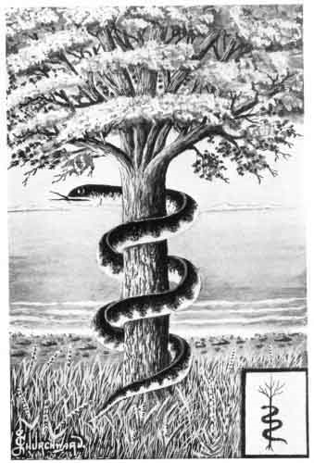
Meaning of “Craft” serpent
"ability to do anything," universally applied in a bad sense to unscrupulous wickedness, that stops short of no measure, however reprehensible, in order to attain its purposes
(From International Standard Bible Encyclopaedia)

Slide 8
“craft” in New testament
18 Do not deceive yourselves. If any of you think you are wise by the standards of this age, you should become "fools" so that you may become wise.
19 For the wisdom of this world is foolishness in God's sight. As it is written: "He catches the wise in their craftiness (1Cor 3:18-19)";

Slide 9
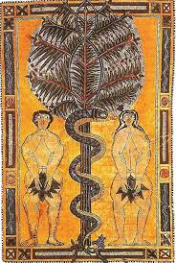
“The FRUIT OF tree”
… the fruit of the tree was good for food and pleasing to the eye, and also desirable for gaining wisdom (Gen 3: 7) …

Slide 10
Theology of sin and Sexuality
Sin as “Wilful Disobedient” of God’s Command
Sin as “Temptation” of Knowing Good and Evil
The Consequence of Sin was The Revelation of lust of sexuality between man and woman.

Slide 11
Jessica’s Story
“My name is Jessica Harris
and I am addicted to pornography.”
FROM http://beggarsdaughter.com/jessicas-story

Slide 12
“The tree of knowledge of good and evil” exists even in our society … to destroy God’s image in us

Slide 13
It can be the media and the lusty messages that craftily temping the holy people of God today.

Slide 14
In response to the crafty Satan’s attempt

