Slide 1
Faith, ______, and Love
1 Thessalonians 3:1-13

Slide 2
Geographical Background

Slide 3
First-Century Circum-Mediterranean World

Slide 4
Paul’s Second Missionary Journey

Slide 5
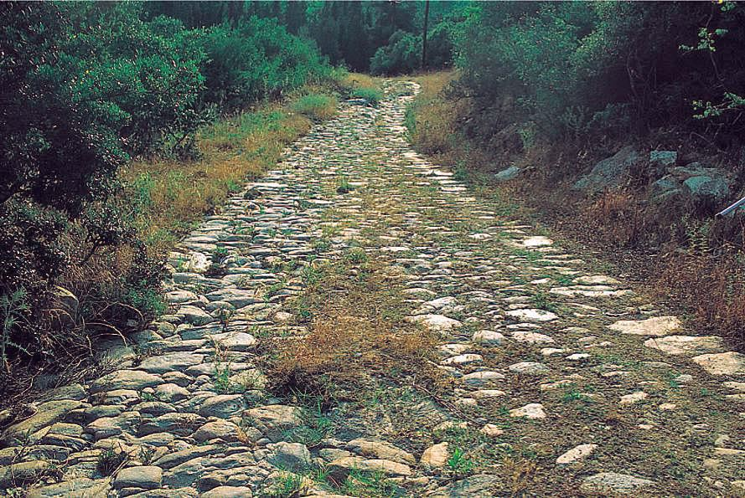
Via Egnatia (“Egnatian Way”)
Notes:
“The Egnatian Way. In order to secure their hold over Macedonia and the Eastern empire, the Romans built the Via Egnatia, a military highway stretching from the west coast of Macedonia all the way to the border of Asia. The apostle Paul would have followed this road from the port city of Neapolis to Philippi, Amphipolis, Apollonia, Thessalonica, and Beroea.” Accordance, PhotoGuide3, “Thessolonica.”

Slide 6
Historical Background
Acts 17

Slide 7
Linguistic Background
Faith and Faithfulness

Slide 8
Canonical Background
1 Corinthaians 13:13
And now these three remain: faith, hope and love. But the greatest of these is love.

Slide 9
1 Thessalonians 3:1-5
The Concern
Were they remaining faithful under persecution?
Timothy went to check on them
(Good news!)

Slide 10
1 Thessalonians 3:6
The Good News
Faith/Faithfulness is going well (vv. 7-8)
Love is going well (v. 6,cf. 4:9-10)

Slide 11
1 Thessalonians 3:6, 10
What’s missing?
Faith, ______, Love (v. 6)
Faith/faithfulness without hope leads to desperation
Love without hope leads to burnout

Slide 12
Application
Faith, Hope, and Love

Slide 13
Faith/Faithfulness
Is your understanding of faith growing?
Are you faithful in spending time with the Lord daily?
Are you faithful to your calling?
Are you able to resist temptation?

Slide 14
Hope
Do you base your hope on Christ’s work on your behalf?
Is your hope based on emotion, or on the certainty of God’s promise?
When you think of the future, what thoughts go through your mind?

Slide 15
Love
Do you love God more today than you did yesterday?
Are your studies making you more loving?
Do you love people and use things, or love things and use people?
Do you love those inside and outside the church?

Slide 20
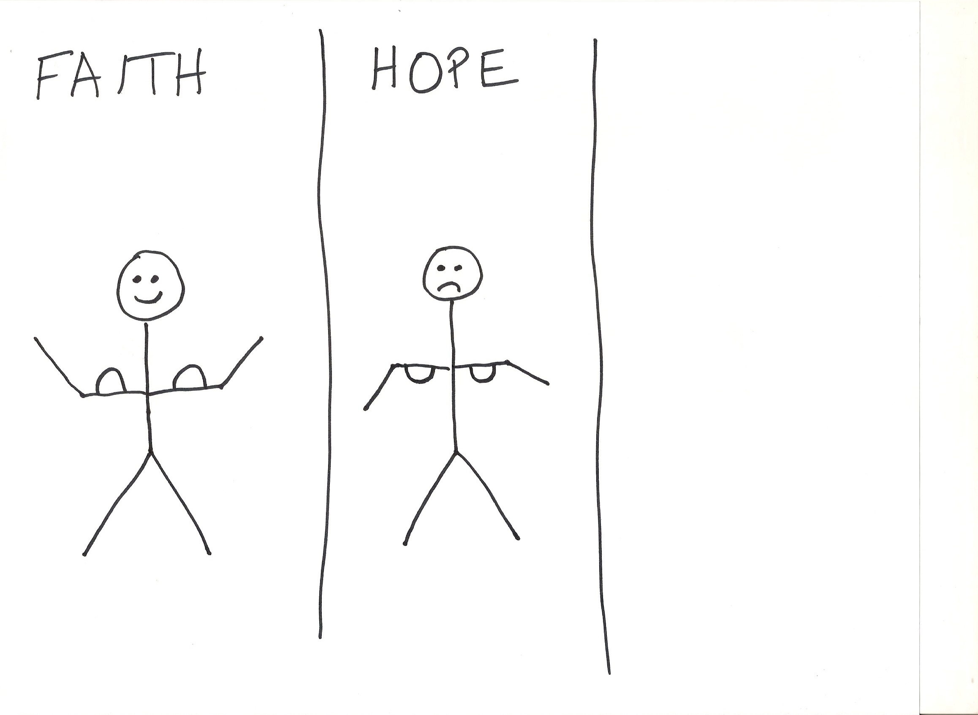

Slide 21
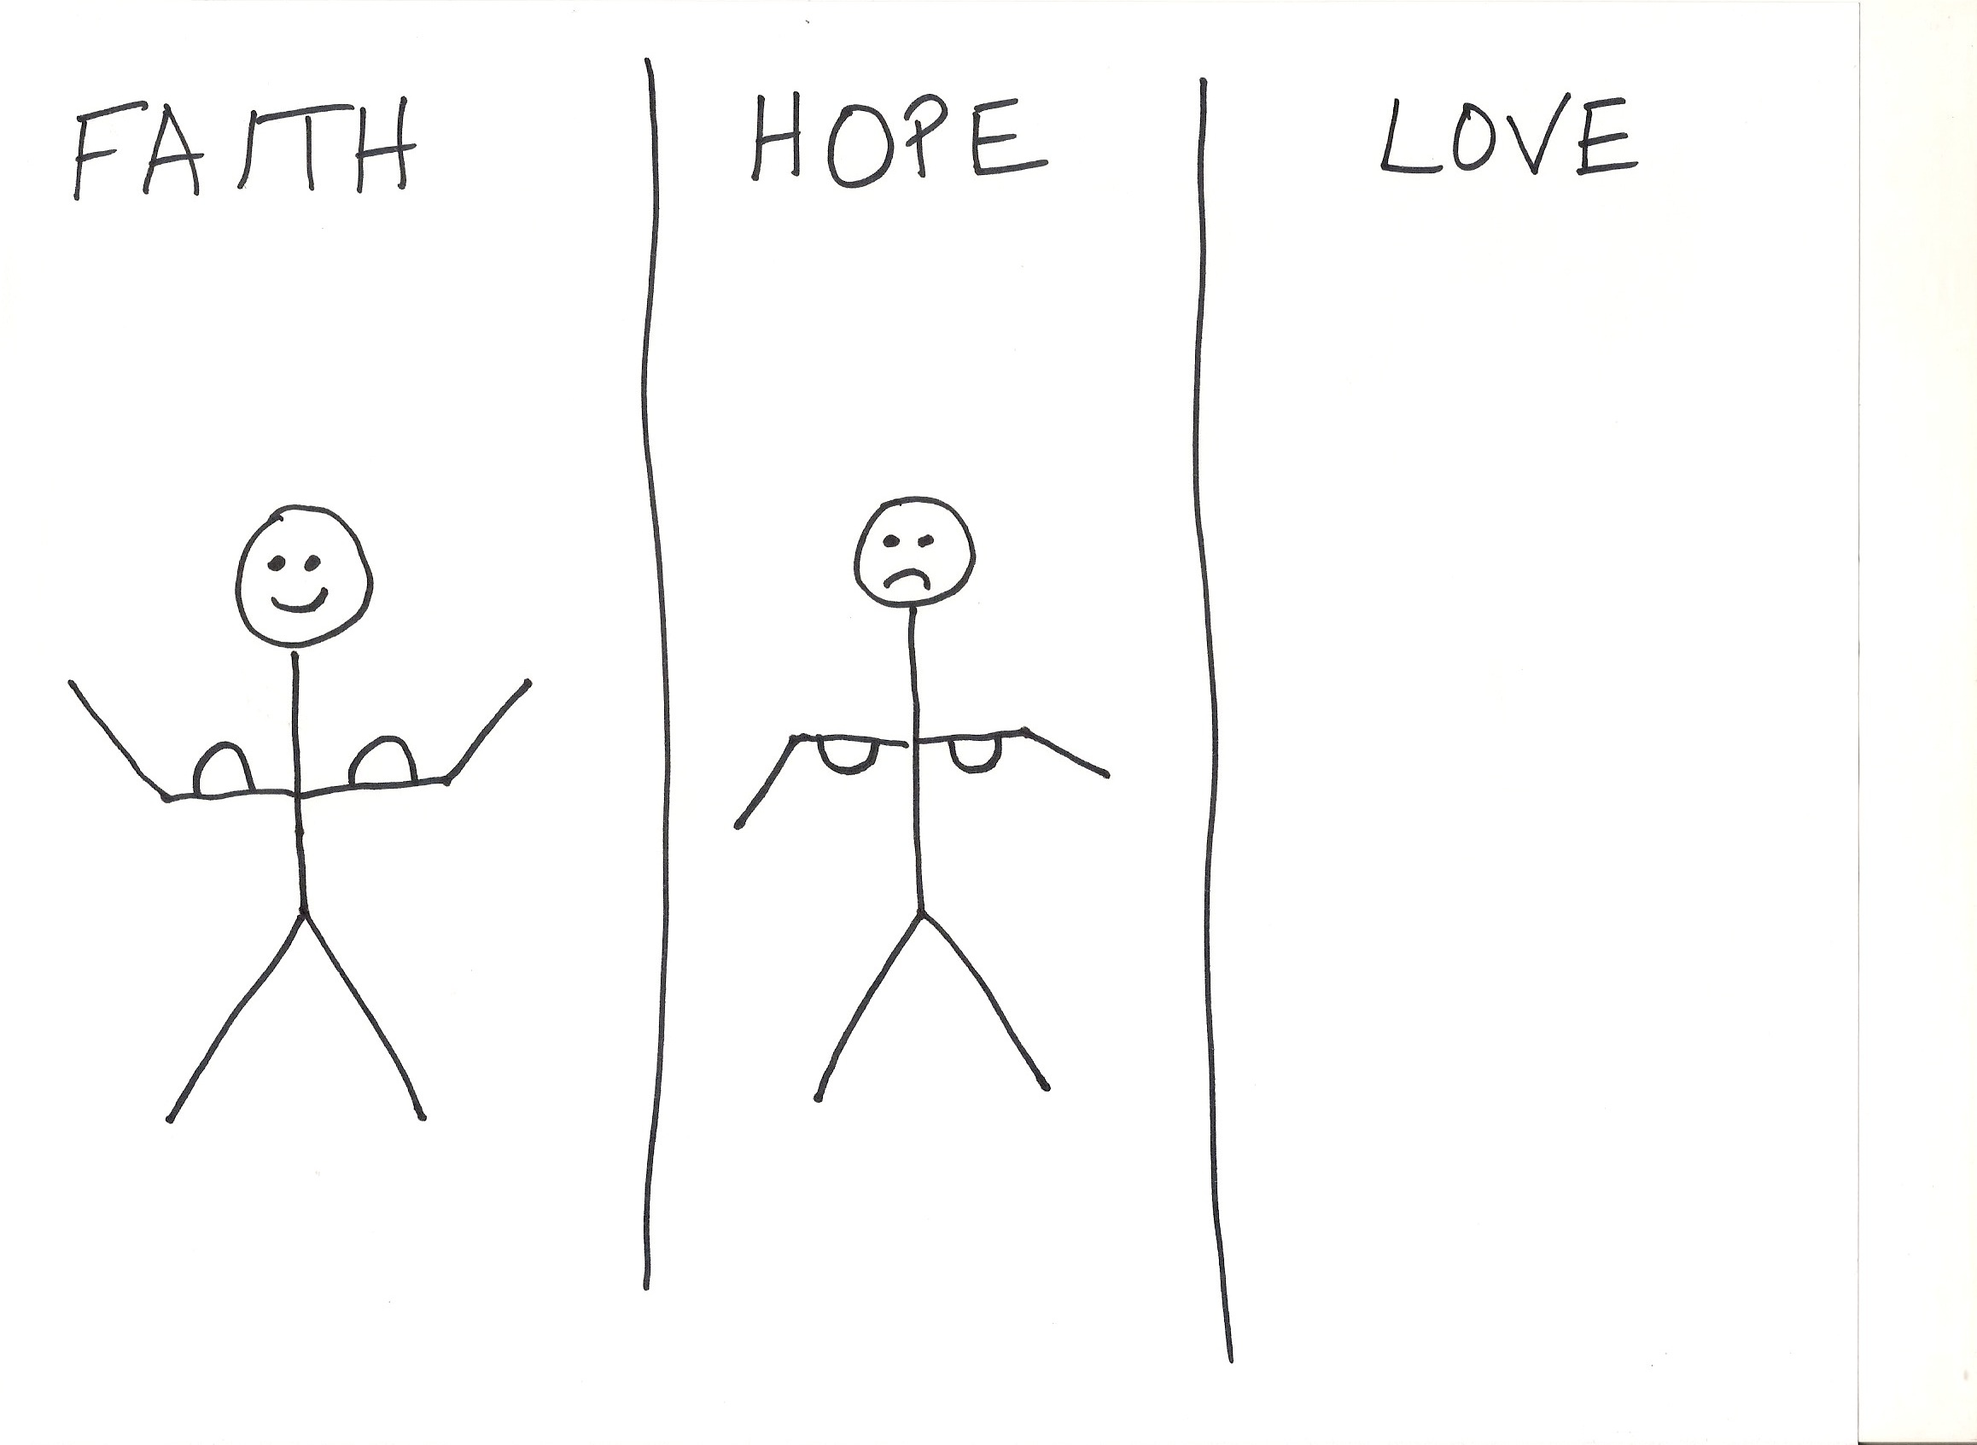

Slide 22
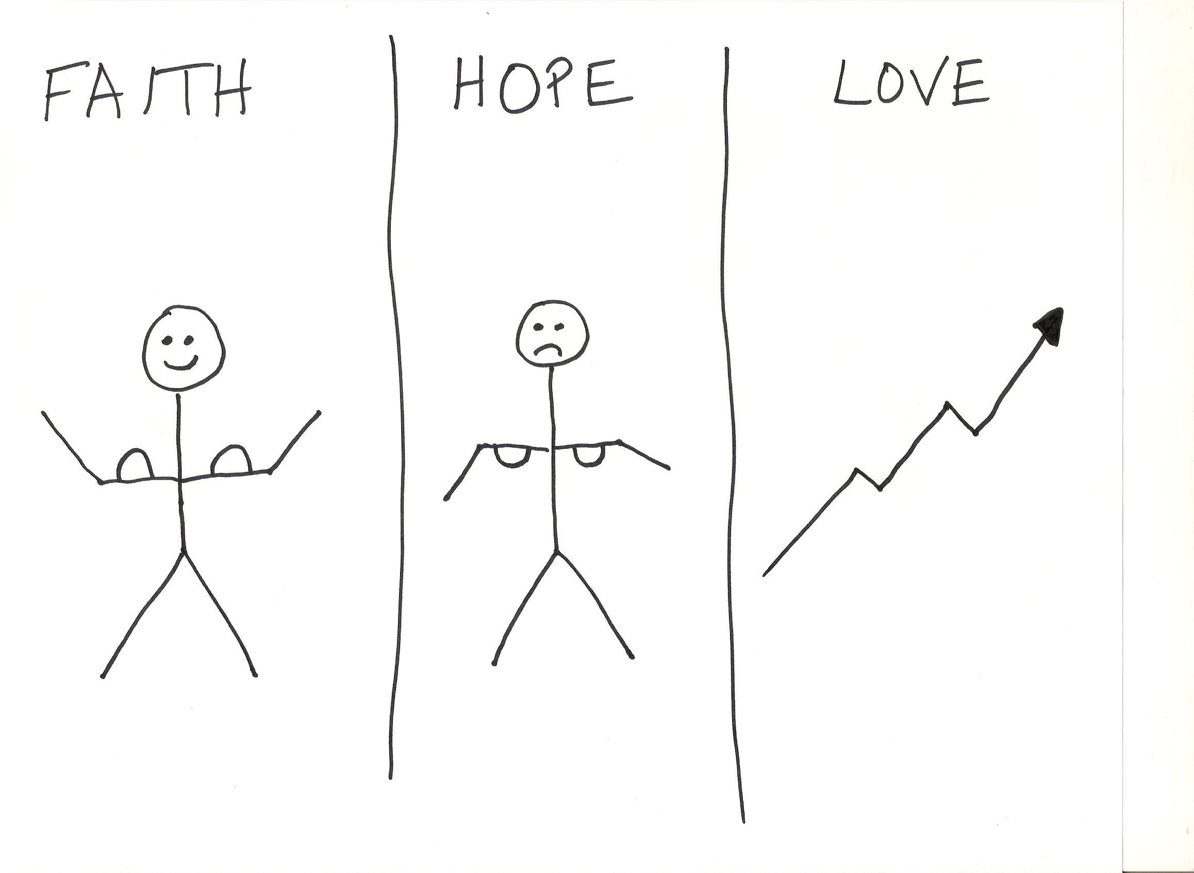

Slide 23
Application
Faith, Hope, and Love
Genuine concern for the spiritual welfare of others

