Slide 1
Message
Dr. Angelito Agbuya

Slide 2
THE GREATNESS OF GOD
Isaiah 40

Slide 3
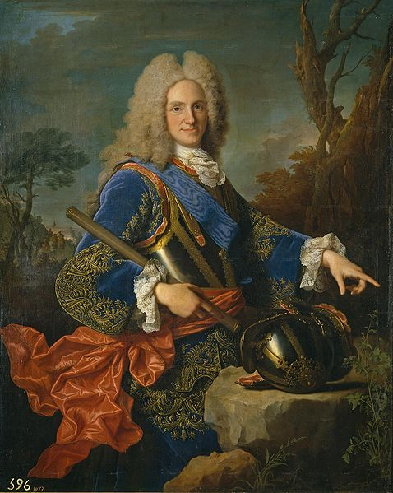
Death of King Louis V

Slide 4
THREE DECLARATIONS OF GOD’S GREATNESS

Slide 5
I. GOD IS GREATER THAN OUR SINS (1-11)
The book of Isaiah has 66 chapters
A two part of book
The author: both a theologian and a pastor
The first words “comfort, comfort my people”
a) the voice of pardon (v.2)
b) the voice of preparation (v. 3-5)
c) the voice of promise (v. 6)
d) the voice of pity (v. 9-11)

Slide 6
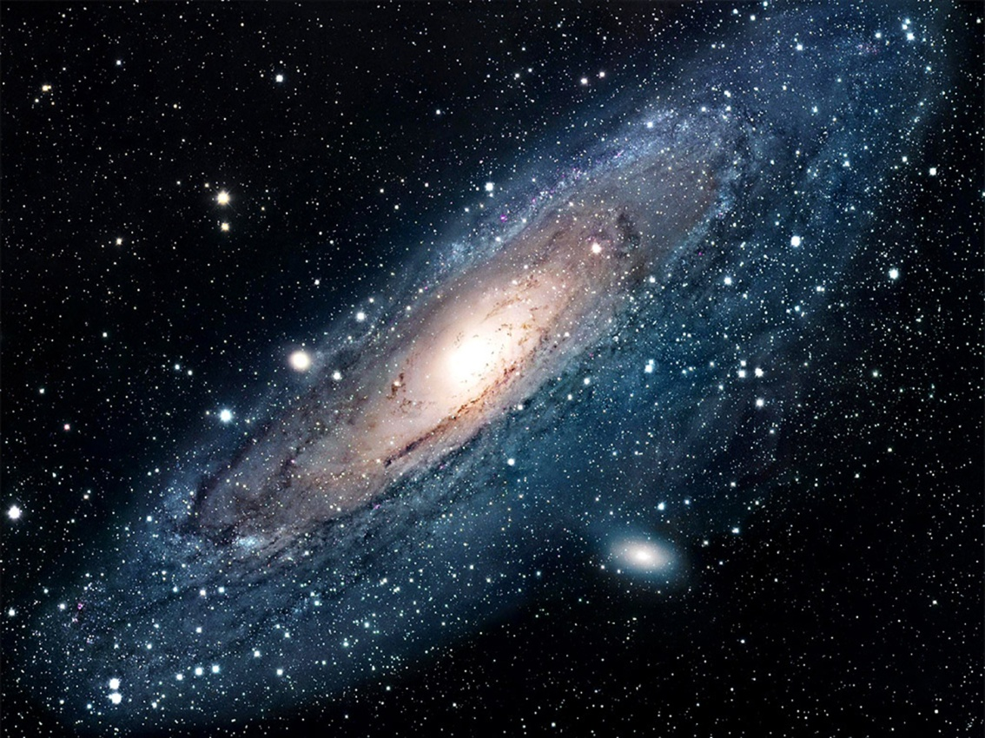
II. GOD IS GREATER THAN OUR CIRCUMSTANCES (12-26)
a) physical world (12-17)
b) heavenly bodies (18,26)

Slide 7
III. GOD IS GREATER THAN OUR FEELINGS (27-31)
“Yard by yard life is hard,
Inch by inch life is a cinch”

Slide 8
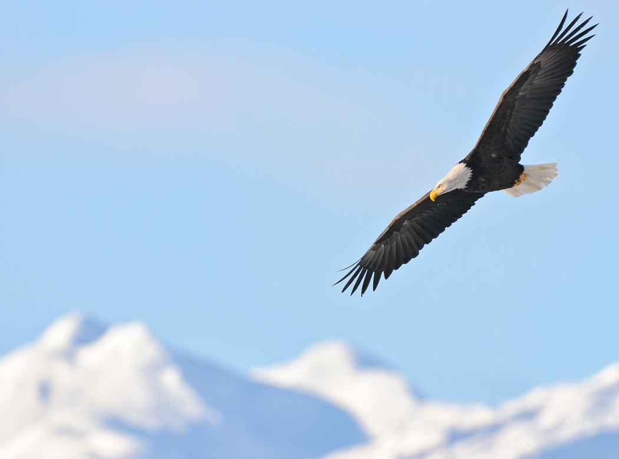
“They that wait upon the Lord shall renew their strength; they shall mount up with wings as eagles; they shall run and not be weary; and they shall walk, and not faint” (31).

Slide 9
Benediction
Dr. Angelito Agbuya

