Slide 1
“On What are You Basing Your Confidence?” Dr. Floyd Cunningham
Acts 3:1-10

Slide 2
¹ One day Peter and John were going up to the temple at the time of prayer—at three in the afternoon.
² Now a man who was lame from birth was being carried to the temple gate called Beautiful, where he was put every day to beg from those going into the temple courts.
³ When he saw Peter and John about to enter, he asked them for money.

Slide 3
⁴Peter looked straight at him, as did John. Then Peter said, “Look at us!”
⁵ So the man gave them his attention, expecting to get something from them.
⁶ Then Peter said, “Silver or gold I do not have, but what I do have I give you. In the name of Jesus Christ of Nazareth, walk.”

Slide 4
⁸ Taking him by the right hand, he helped him up, and instantly the man’s feet and ankles became strong. 8 He jumped to his feet and began to walk. Then he went with them into the temple courts, walking and jumping, and praising God.
⁹ When all the people saw him walking and praising God,
¹⁰ they recognized him as the same man who used to sit begging at the temple gate called Beautiful, and they were filled with wonder and amazement at what had happened to him.

Slide 5
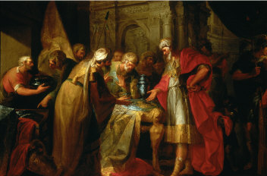
Hezekiah gave up the silver and gold.
On what does your confidence rest?
What tempts you to give up?

Slide 6
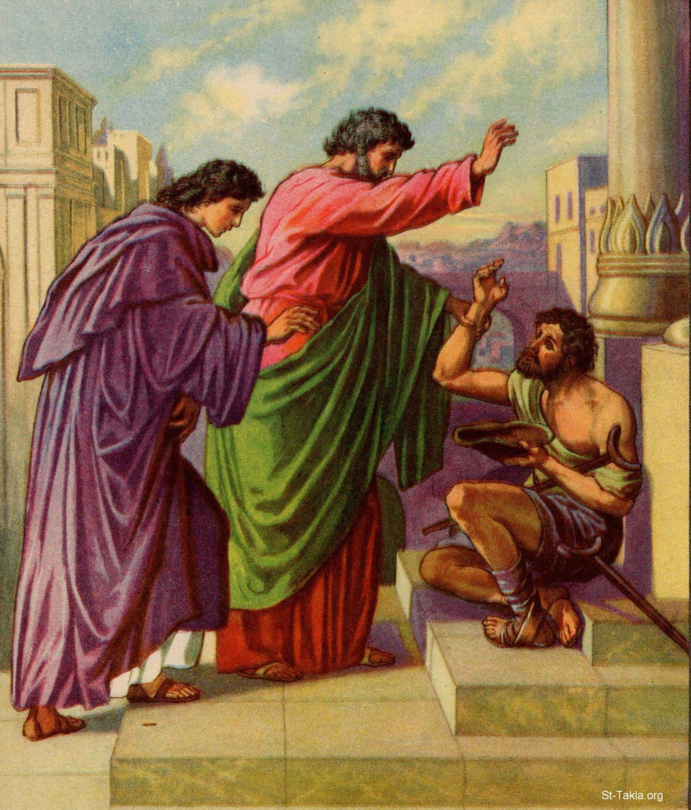
“In the name of Jesus Christ of Nazareth, walk!”

Slide 7
APPLICATION
What is the meaning of all of this for us?
Silver and gold have we none!
Stripped away of everything upon which we have confidence, we too are forced to see our own weakness, and rely wholly on the mercy of God.

Slide 8
In our weakness, in our frailty, in our own “crippled” condition – spiritually, morally, emotionally, physically: there is HOPE. You are loved. Have faith. Your Healer, the Great Physician is here. He has not overlooked you. He asks you to look up, to look at him. Rise and be healed! Walk!
Up from our “crippledness,” we convey to others: HOPE; have faith; you are loved.

Slide 9
Special Music Joy Pring

Slide 10
RESPONSE PRAYER (In Unison)

Slide 11
Our Father, as we this day live and pray,
empower us your word and will obey.
Direct our sight straight and not away into the hearts and needs of crippled souls.
Enable us to offer love, faith, and hope to those whose confidence is built on something less than the Resurrected Son.

Slide 12
Should we feel too, our crippled lives, our misplaced faith, and lack of trust; should we feel all around our soul give way, be still, oh Lord, our Hope and stay. Should we feel tempted Lord, to depend on our own strength, lift up our eyes to you, oh Lord.
In you alone, Lord Jesus Christ, we place our trust and our confidence, and lift this prayer.

Slide 13
BENEDICTION
Fear not, God is with you.
Be not dismayed.
He is your God,
He will still give you aid.
May the Spirit strengthen you,
Christ help you,
And cause you to stand,
Upheld by God’s gracious, omnipotent hand. Amen.

